Slide 1
Kernel Image Processing with CUDA
Parallel Computing
(Final-Term Assignment)
Davide Del Bimbo
davide.delbimbo@edu.unifi.it
11/01/2024

Slide 2

Kernel Image Processing with CUDA
Introduction
Introduction
An image is composed of pixels and each pixel consists of a primary colors combination.
Kernels allow certain operations to be performed on images (blurring, edge detection, sharpening, etc…).
A kernel is a small matrix representing a function to be applied to an original input image:
Each pixel in the processed output image represents a function of nearby pixels in the input image.
The operation we apply is known as convolution:
$$g\left(x,y\right)=ω⨂f\left(x,y\right)=\sum_{i=−a}^{a}{\sum_{j=−b}^{b}{ω(i,j)⋅f(x−i,y−j)}}$$

Slide 3
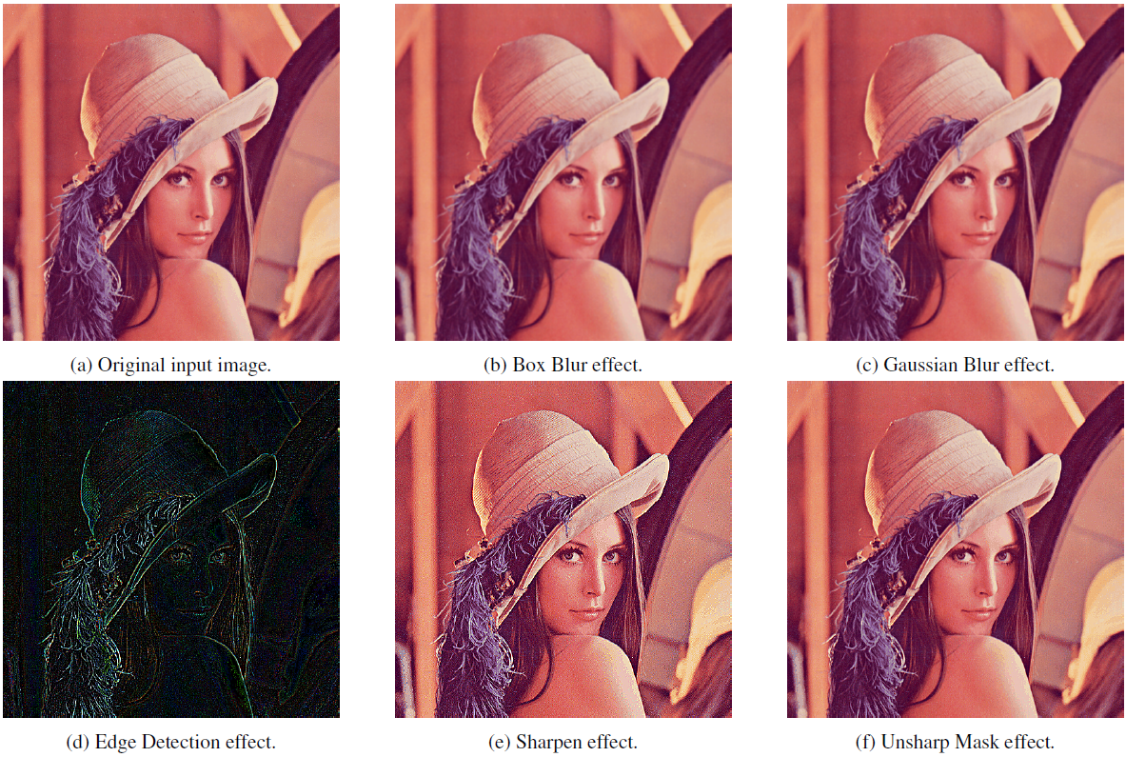
Kernel Image Processing with CUDA
Introduction
Different types of filter kernels (depending on kernel coefficients):
Box blur.
Gaussian blur.
Edge detection.
Sharpen.
Unsharp Mask.
…

Slide 4
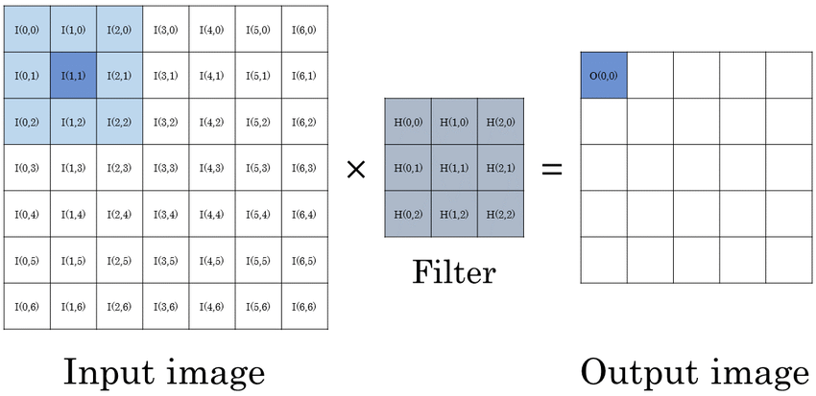

Kernel Image Processing with CUDA
Algorithm
Algorithm
Get a feature map $f$and a kernel $ω$.
For each pixel in $f:$
Set an accumulator to $0.$
Perform the convolution. For each element in $ω$, if element position corresponds to pixel position, then:
$$\text{accumulator}+=\text{pixel} ∗\text{element}$$
Set the corresponding output pixel of $g$ to accumulator.

Slide 5
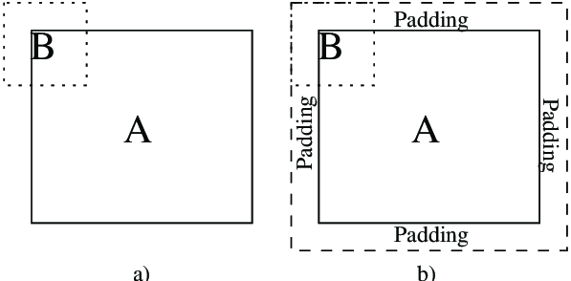
Kernel Image Processing with CUDA
Padding
Padding
Handle boundary cases in which the convolution is performed on pixels located at the edges of the input image.

Slide 6
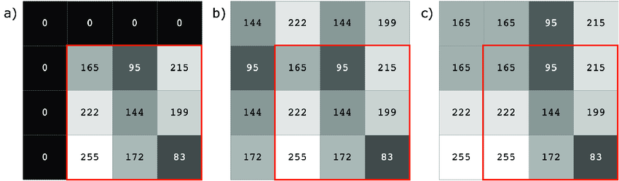
Kernel Image Processing with CUDA
Padding
Different type of padding:
Constant.
Replicate.
Mirrror.
…

Slide 7
K-Means Clustering with OpenMP
Implementation
Implementation
Image: class representing a multi-channel image.
width, height, channels: image sizes (int).
data: array containing multi-channel image data (uint8_t).
is_SoA: image architecture (bool).
Kernel: class representing a two-dimensional kernel.
width, height: kernel sizes (int).
data: array containing kernel data (uint8_t).

Slide 8
K-Means Clustering with OpenMP
Implementation
// Image in multi-channel space.
class Image {
private:
int width = 0, height = 0, channels = 0; // Image dimensions.
float *data = NULL; // Kernel data.
bool is_SoA = false; // SoA flag.
public:
Image(const char* filename, const int channel_force, const bool is_SoA);
bool load_image(const char* filename, const int channel_force);
void save_image(const char* filename);
Image padding(const int padding_width, const int padding_height);
uint8_t& operator()(const int col, const int row, const int channel) const;
bool operator==(const Image& other) const;
void AoS_to_SoA();
}
// Kernel in 2D space.
class Kernel {
private:
int width = 0, height = 0; // Kernel dimensions.
float *data = NULL; // Kernel data.
public:
Kernel(const int width, const int height, float *data);
float& operator()(const int col, const int row) const;
}

Slide 9
K-Means Clustering with OpenMP
Implementation
// Image in multi-channel space.
class Image {
private:
int width = 0, height = 0, channels = 0; // Image dimensions.
float *data = NULL; // Kernel data.
bool is_SoA = false; // SoA flag.
public:
Image(const char* filename, const int channel_force, const bool is_SoA);
bool load_image(const char* filename, const int channel_force);
void save_image(const char* filename);
Image padding(const int padding_width, const int padding_height);
uint8_t& operator()(const int col, const int row, const int channel) const;
bool operator==(const Image& other) const;
void AoS_to_SoA();
}
// Kernel in 2D space.
class Kernel {
private:
int width = 0, height = 0; // Kernel dimensions.
float *data = NULL; // Kernel data.
public:
Kernel(const int width, const int height, float *data);
float& operator()(const int col, const int row) const;
}

Slide 10
K-Means Clustering with OpenMP
Implementation
// Image in multi-channel space.
class Image {
private:
int width = 0, height = 0, channels = 0; // Image dimensions.
float *data = NULL; // Kernel data.
bool is_SoA = false; // SoA flag.
public:
Image(const char* filename, const int channel_force, const bool is_SoA);
bool load_image(const char* filename, const int channel_force);
void save_image(const char* filename);
Image padding(const int padding_width, const int padding_height);
uint8_t& operator()(const int col, const int row, const int channel) const;
bool operator==(const Image& other) const;
void AoS_to_SoA();
}
uint8_t &Image::operator()(const int col, const int row, const int channel) const { // Get the 1D pixel index.
const int pixel_index = is_SoA ?
((channel * width * height) + (row * width) + col) :
((row * width + col) * channels + channel);
return data[pixel_index];
}
// Kernel in 2D space.
class Kernel {
private:
int width = 0, height = 0; // Kernel dimensions.
float *data = NULL; // Kernel data.
public:
Kernel(const int width, const int height, float *data);
float& operator()(const int col, const int row) const;
}

Slide 11
K-Means Clustering with OpenMP
Implementation
// Image in multi-channel space.
class Image {
private:
int width = 0, height = 0, channels = 0; // Image dimensions.
float *data = NULL; // Kernel data.
bool is_SoA = false; // SoA flag.
public:
Image(const char* filename, const int channel_force, const bool is_SoA);
bool load_image(const char* filename, const int channel_force);
void save_image(const char* filename);
Image padding(const int padding_width, const int padding_height);
uint8_t& operator()(const int col, const int row, const int channel) const;
bool operator==(const Image& other) const;
void AoS_to_SoA();
}
// Kernel in 2D space.
class Kernel {
private:
int width = 0, height = 0; // Kernel dimensions.
float *data = NULL; // Kernel data.
public:
Kernel(const int width, const int height, float *data);
float& operator()(const int col, const int row) const;
}

Slide 12
K-Means Clustering with OpenMP
Implementation
// Image in multi-channel space.
class Image {
private:
int width = 0, height = 0, channels = 0; // Image dimensions.
float *data = NULL; // Kernel data.
bool is_SoA = false; // SoA flag.
public:
Image(const char* filename, const int channel_force, const bool is_SoA);
bool load_image(const char* filename, const int channel_force);
void save_image(const char* filename);
Image padding(const int padding_width, const int padding_height);
uint8_t& operator()(const int col, const int row, const int channel) const;
bool operator==(const Image& other) const;
void AoS_to_SoA();
}
// Kernel in 2D space.
class Kernel {
private:
int width = 0, height = 0; // Kernel dimensions.
float *data = NULL; // Kernel data.
public:
Kernel(const int width, const int height, float *data);
float& operator()(const int col, const int row) const;
}
float &Kernel::operator()(const int col, const int row) const { // Get the 1D kernel index.
const int kernel_index = (row * width) + col;
return data[kernel_index];
}

Slide 13
K-Means Clustering with OpenMP
Sequential implementation
Sequential Implementation
Convolution: method to perform the convolution operation:
Get padded image and kernel.
Returns convolved image.
Convolve: method to execute convolution operation several times and calculate the average execution time.

Slide 14
K-Means Clustering with OpenMP
Sequential implementation
Image convolution(const Image& image, const Kernel& kernel, const Image& padded_image) {
// Initialize the output image.
Image output_image = Image(width, height, channels, image.get_is_SoA()); // Output image.
// Iterate over the image.
for (int channel = 0; channel < channels; channel++) {
for (int y = 0; y < height; y++) {
for (int x = 0; x < width; x++) {
// Output value for the current pixel.
float output_value = 0;
// Iterate over the kernel.
for (int ky = 0; ky < kernel_height; ky++) {
for (int kx = 0; kx < kernel_width; kx++) {
// Get the pixel index to be convolved.
const int col = x + kx - floor((float)kernel_width/2) + padding_width;
const int row = y + ky - floor((float)kernel_width/2) + padding_height;
// Convolve the pixel.
output_value += padded_image(col, row, channel) * kernel(kx, ky);
}
}
// Set the output value (clamped between 0 and 255).
output_image(x, y, channel) = (uint8_t)clamp(0.0f, output_value, 255.0f);
}
}
}
// Return the convolved image.
return output_image;
}

Slide 15
K-Means Clustering with OpenMP
Parallel implementation
Parallel implementation
Implemented with CUDA to exploit the power of the GPU.
Convolution operation represents an embarrassingly parallel problem:
Depends exclusively on the pixel values in the original input image and the kernel coefficients.
These values are only read and never changed during the convolution operation.
The output pixels are written only once and by only one thread.
Therefore, each thread can read, perform the convolution operation and write the output to memory without the need of synchronization with other threads.

Slide 16
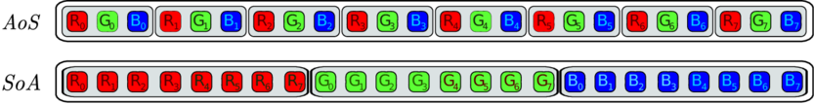
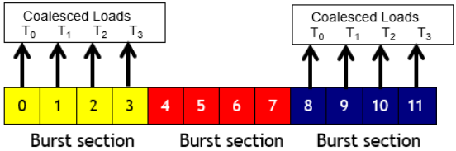
K-Means Clustering with OpenMP
Parallel implementation
Can use SoA architecture to enable coalesced memory access:
SoA architecture turns out to be more cache-friendly, enhancing spatial and temporal locality of data.
In fact, during a read of an element, some following values are also loaded into the cache due to memory burst.
This allow consecutive threads to access consecutive memory addresses, ensuring coalesced memory access.

Slide 17
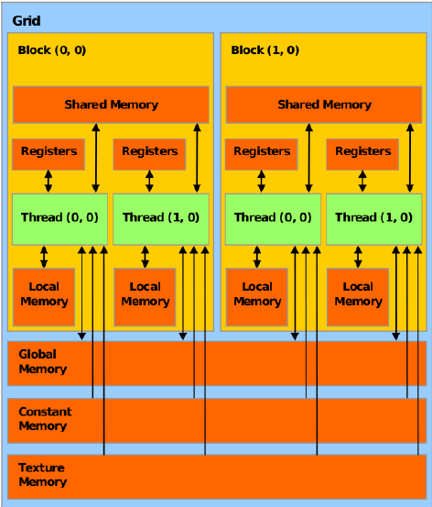
K-Means Clustering with OpenMP
Parallel implementation
Different level of device memory:
Global memory: is the main and slowest memory in the device. Is shared among all blocks in the grid.
Constant memory: is a small and fast memory that can be used to store variables that will not be changed during processing. Is shared among all blocks in the grid.
Shared memory: is a small and low-latency memory, shared among all threads in a block.

Slide 18
K-Means Clustering with OpenMP
Parallel implementation
Allocate the correct amount of memory in the device to store the data needed for thread processing:
cudaMalloc.
Data transfer from the host to the device:
cudaMemCpy (in cudaMemcpyHostToDevice).
cudaMemcpyToSymbol (in cudaMemcpyHostToDevice).
Execute the kernel by defining the correct number of threads per block and blocks per grid.
Data transfer from the device to the host:
cudaMemCpy (in cudaMemcpyDeviceToHost).

Slide 19
K-Means Clustering with OpenMP
Parallel implementation
Global memory kernel (one thread compute convolution with nearby pixel):
__global__ void convolution_kernel_global(uint8_t* d_input, float* d_kernel, uint8_t* d_output,
int width, int height, int channels,
int kernel_width, int kernel_height,
int padding_width, int padding_height, bool is_SoA)
{
// Calculate the global index in the output image.
const int x = blockIdx.x * blockDim.x + threadIdx.x; // Column index.
const int y = blockIdx.y * blockDim.y + threadIdx.y; // Row index.
// Check if the thread is within the image bounds.
if(x < width && y < height) {
for(int channel = 0; channel < channels; channel++) {
// Output value for the current pixel.
float output_value = 0.0f;
// Iterate over the kernel.
for(int ky = 0; ky < kernel_height; ky++) {
for(int kx = 0; kx < kernel_width; kx++) {
// Get the pixel index to be convolved.
const int col = x + kx - floor((float)kernel_width/2) + padding_width;
const int row = y + ky - floor((float)kernel_height/2) + padding_height; // Add the convolution value to the output value.
output_value += get_pixel_value(d_input, col, row, channel, padded_width, padded_height, channels, is_SoA) * get_kernel_value(d_kernel, kx, ky, kernel_width, kernel_height);
}
}
// Store the output value in global memory.
set_pixel_value(d_output, x, y, channel, width, height, channels, is_SoA,
(uint8_t)clamp(0.0f, output_value, 255.0f));
}
}
}

Slide 20
K-Means Clustering with OpenMP
Parallel implementation
__global__ void convolution_kernel_global(uint8_t* d_input, float* d_kernel, uint8_t* d_output,
int width, int height, int channels,
int kernel_width, int kernel_height,
int padding_width, int padding_height, bool is_SoA)
{
// Calculate the global index in the output image.
const int x = blockIdx.x * blockDim.x + threadIdx.x; // Column index.
const int y = blockIdx.y * blockDim.y + threadIdx.y; // Row index.
// Check if the thread is within the image bounds.
if(x < width && y < height) {
for(int channel = 0; channel < channels; channel++) {
// Output value for the current pixel.
float output_value = 0.0f;
// Iterate over the kernel.
for(int ky = 0; ky < kernel_height; ky++) {
for(int kx = 0; kx < kernel_width; kx++) {
// Get the pixel index to be convolved.
const int col = x + kx - floor((float)kernel_width/2) + padding_width;
const int row = y + ky - floor((float)kernel_height/2) + padding_height; // Add the convolution value to the output value.
output_value += get_pixel_value(d_input, col, row, channel, padded_width, padded_height, channels, is_SoA) * get_kernel_value(d_kernel, kx, ky, kernel_width, kernel_height);
}
}
// Store the output value in global memory.
set_pixel_value(d_output, x, y, channel, width, height, channels, is_SoA,
(uint8_t)clamp(0.0f, output_value, 255.0f));
}
}
}

Slide 21
K-Means Clustering with OpenMP
Parallel implementation
__global__ void convolution_kernel_global(uint8_t* d_input, float* d_kernel, uint8_t* d_output,
int width, int height, int channels,
int kernel_width, int kernel_height,
int padding_width, int padding_height, bool is_SoA)
{
// Calculate the global index in the output image.
const int x = blockIdx.x * blockDim.x + threadIdx.x; // Column index.
const int y = blockIdx.y * blockDim.y + threadIdx.y; // Row index.
// Check if the thread is within the image bounds.
if(x < width && y < height) {
for(int channel = 0; channel < channels; channel++) {
// Output value for the current pixel.
float output_value = 0.0f;
// Iterate over the kernel.
for(int ky = 0; ky < kernel_height; ky++) {
for(int kx = 0; kx < kernel_width; kx++) {
// Get the pixel index to be convolved.
const int col = x + kx - floor((float)kernel_width/2) + padding_width;
const int row = y + ky - floor((float)kernel_height/2) + padding_height; // Add the convolution value to the output value.
output_value +=
get_pixel_value(d_input, col, row, channel, padded_width, padded_height, channels, is_SoA)
* get_kernel_value(d_kernel, kx, ky, kernel_width, kernel_height);
}
}
// Store the output value in global memory.
set_pixel_value(d_output, x, y, channel, width, height, channels, is_SoA,
(uint8_t)clamp(0.0f, output_value, 255.0f));
}
}
}
__device__ uint8_t& get_pixel_value(uint8_t* d_input, const int col, const int row, const int channel, const int width, const int height, const int channels, const bool is_SoA) {
// Get the 1D pixel index.
const int pixel_index = is_SoA ?
((channel * width * height) + (row * width) + col) :
((row * width + col) * channels + channel);
return d_input[pixel_index];
}

Slide 22
K-Means Clustering with OpenMP
Parallel implementation
__global__ void convolution_kernel_global(uint8_t* d_input, float* d_kernel, uint8_t* d_output,
int width, int height, int channels,
int kernel_width, int kernel_height,
int padding_width, int padding_height, bool is_SoA)
{
// Calculate the global index in the output image.
const int x = blockIdx.x * blockDim.x + threadIdx.x; // Column index.
const int y = blockIdx.y * blockDim.y + threadIdx.y; // Row index.
// Check if the thread is within the image bounds.
if(x < width && y < height) {
for(int channel = 0; channel < channels; channel++) {
// Output value for the current pixel.
float output_value = 0.0f;
// Iterate over the kernel.
for(int ky = 0; ky < kernel_height; ky++) {
for(int kx = 0; kx < kernel_width; kx++) {
// Get the pixel index to be convolved.
const int col = x + kx - floor((float)kernel_width/2) + padding_width;
const int row = y + ky - floor((float)kernel_height/2) + padding_height; // Add the convolution value to the output value.
output_value += get_pixel_value(d_input, col, row, channel, padded_width, padded_height, channels, is_SoA) * get_kernel_value(d_kernel, kx, ky, kernel_width, kernel_height);
}
}
// Store the output value in global memory.
set_pixel_value(d_output, x, y, channel, width, height, channels, is_SoA,
(uint8_t)clamp(0.0f, output_value, 255.0f));
}
}
}

Slide 23
K-Means Clustering with OpenMP
Parallel implementation
__global__ void convolution_kernel_global(uint8_t* d_input, float* d_kernel, uint8_t* d_output,
int width, int height, int channels,
int kernel_width, int kernel_height,
int padding_width, int padding_height, bool is_SoA)
{
// Calculate the global index in the output image.
const int x = blockIdx.x * blockDim.x + threadIdx.x; // Column index.
const int y = blockIdx.y * blockDim.y + threadIdx.y; // Row index.
// Check if the thread is within the image bounds.
if(x < width && y < height) {
for(int channel = 0; channel < channels; channel++) {
// Output value for the current pixel.
float output_value = 0.0f;
// Iterate over the kernel.
for(int ky = 0; ky < kernel_height; ky++) {
for(int kx = 0; kx < kernel_width; kx++) {
// Get the pixel index to be convolved.
const int col = x + kx - floor((float)kernel_width/2) + padding_width;
const int row = y + ky - floor((float)kernel_height/2) + padding_height; // Add the convolution value to the output value.
output_value +=
get_pixel_value(d_input, col, row, channel, padded_width, padded_height, channels, is_SoA)
* get_kernel_value(d_kernel, kx, ky, kernel_width, kernel_height);
}
}
// Store the output value in global memory.
set_pixel_value(d_output, x, y, channel, width, height, channels, is_SoA,
(uint8_t)clamp(0.0f, output_value, 255.0f));
}
}
}
__device__ float& get_kernel_value(float* d_kernel, const int col, const int row, const int width, const int height) {
// Get the 1D kernel index.
const int kernel_index = (row * width) + col;
return d_kernel[kernel_index];
}

Slide 24
K-Means Clustering with OpenMP
Parallel implementation
Define a constant memory to store filter (constant variable).
__constant__ float c_kernel[MAX_MASK_WIDTH * MAX_MASK_WIDTH];
Similar to global memory kernel (change only the kernel definition for filter parameter and multiplication).
__global__ void convolution_kernel_constant(uint8_t* d_input, uint8_t* d_output,
int width, int height, int channels,
int kernel_width, int kernel_height,
int padding_width, int padding_height, bool is_SoA);
output_value += get_pixel_value(d_input, col, row, channel, padded_width, padded_height, channels, is_SoA) * get_kernel_value(c_kernel, kx, ky, kernel_width, kernel_height);

Slide 25
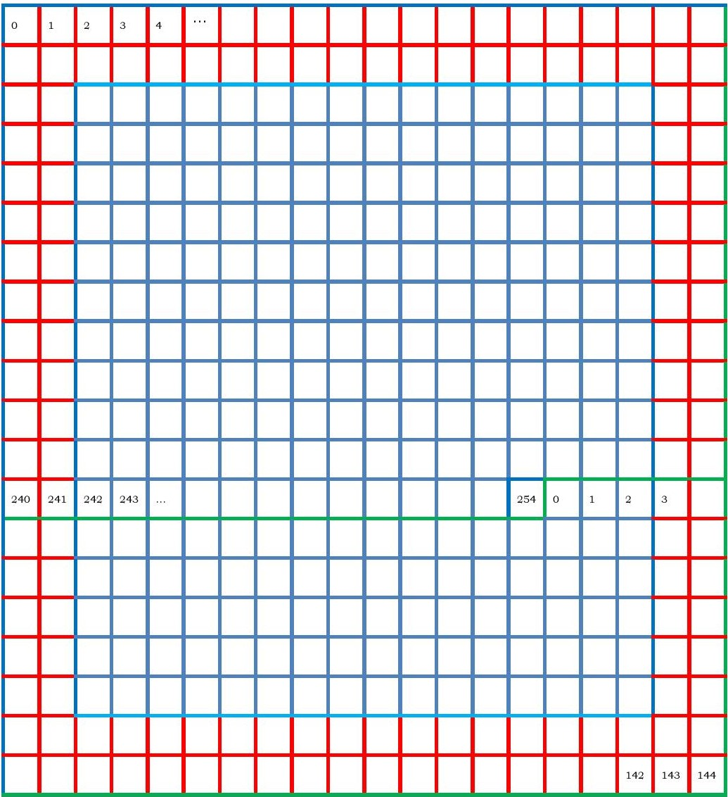
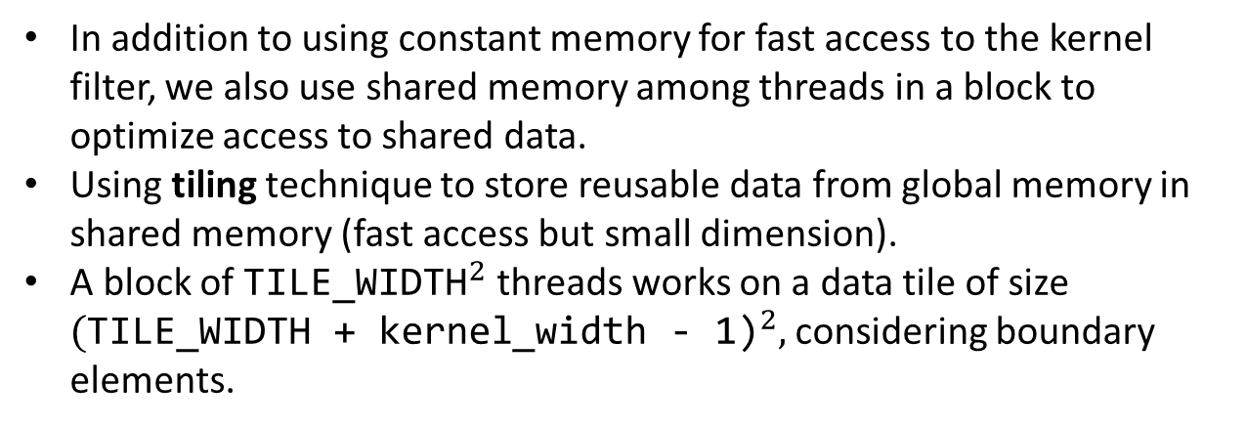
K-Means Clustering with OpenMP
Parallel implementation
In addition to using constant memory for fast access to the kernel filter, we also use shared memory among threads in a block to optimize access to shared data.
Using tiling technique to store reusable data from global memory in shared memory (fast access but small dimension).
A block of ${\text{TILE}\text{_}\text{WIDTH}}^{2}$ threads works on a data tile of size ${\text{(}\text{TILE}\text{_}\text{WIDTH}\text{ + }\text{kernel}\text{_}\text{width}\text{ − 1)}}^{2},$considering boundary elements.

Slide 26
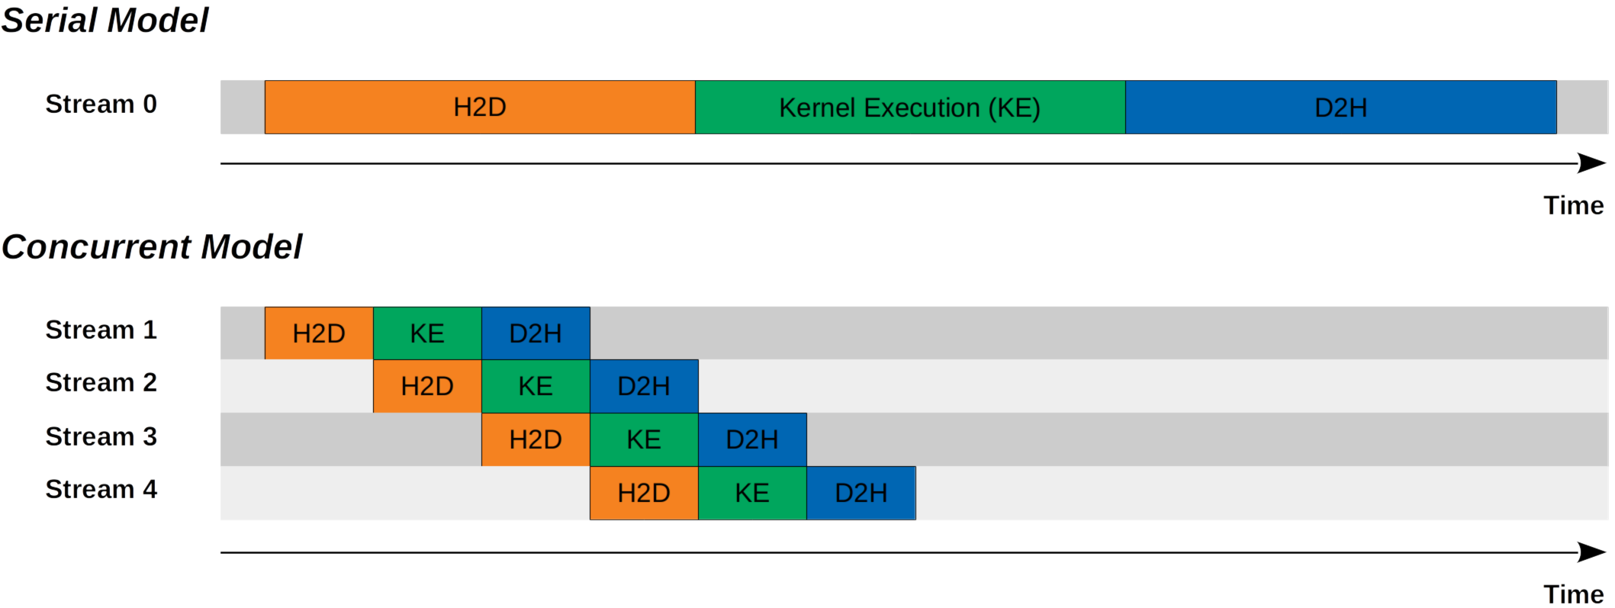
K-Means Clustering with OpenMP
Parallel implementation
Primary cost in CUDA implementation is data transfer between host and device.
Explore asynchronous solution using pinned memory and CUDA streams:
Pinned memory for faster host-device communication. It is memory physically locked in RAM, which the operating system cannot access.
Partition kernel workloads with CUDA streams.
Transfer data concurrently while a kernel is in execution.
Reduces idle time.

Slide 27

K-Means Clustering with OpenMP
Performance
Performance
Analysis of speedup as the input image resolutions and filter sizes change:
Images 480p, 720p, HD, 4k and 8K, with a Gaussian Blur $3×3$ filter.
Filters $3×3$, $5×5$, $7×7$ and $9×9$, with HD image.
Comparison of memory levels.
Comparison of AoS and SoA architectures.
Comparison of synchronous and asynchronous loading models.

Slide 28
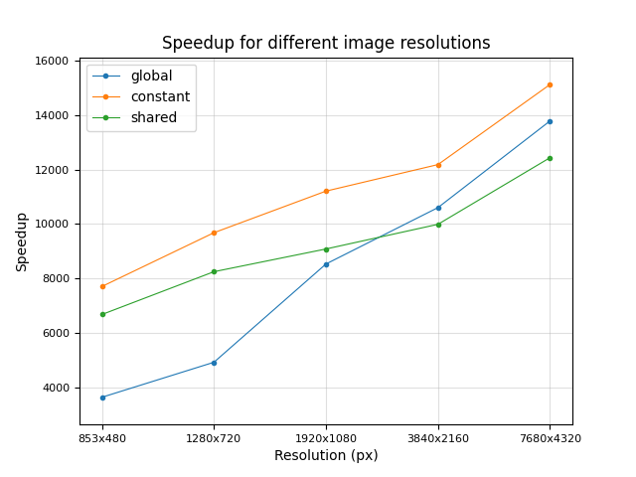
K-Means Clustering with OpenMP
Performance
Speedup as the resolution changes:
 | Global | Constant | Shared
480p | 3645.86 | 7709.04 | 6682.36
720p | 4929.97 | 9681.91 | 8251.72
HD | 8534.28 | 11207.86 | 9084.96
4K | 10602.63 | 12181.03 | 9990.22
8K | 13780.7 | 15118.17 | 12433

Slide 29
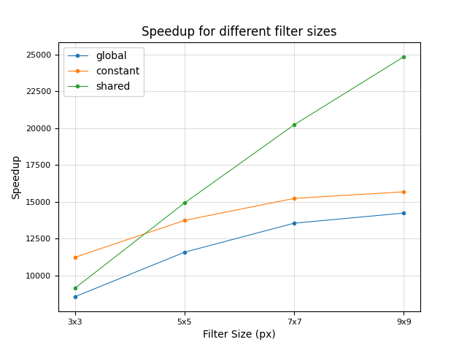
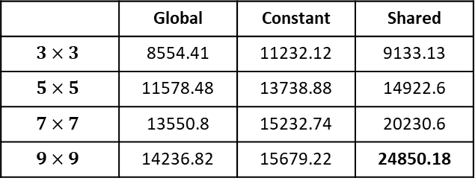
K-Means Clustering with OpenMP
Performance
Speedup as the filter sizes changes:
 | Global | Constant | Shared
$$3×3$$ | 8554.41 | 11232.12 | 9133.13
$$5×5$$ | 11578.48 | 13738.88 | 14922.6
$$7×7$$ | 13550.8 | 15232.74 | 20230.6
$$9×9$$ | 14236.82 | 15679.22 | 24850.18

Slide 30
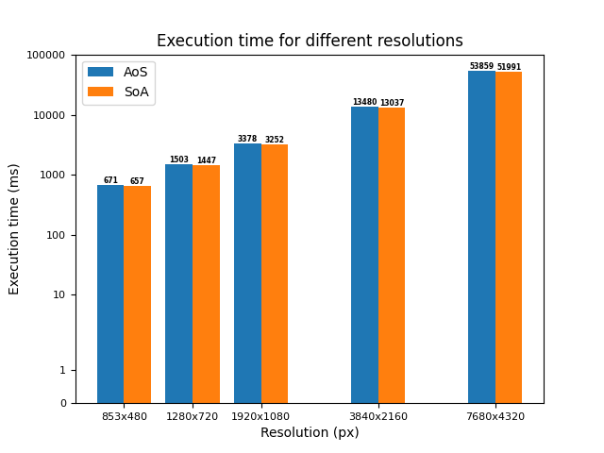
K-Means Clustering with OpenMP
Performance
AoS vs SoA:

Slide 31
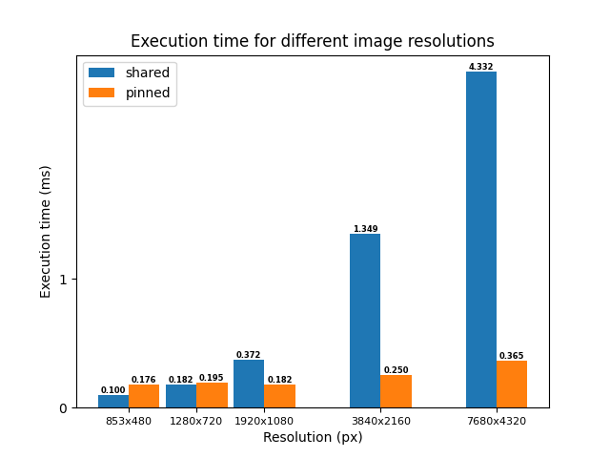
K-Means Clustering with OpenMP
Performance
Synchronous vs asynchronous loading models:

Slide 32
K-Means Clustering with OpenMP
Conclusions
Conclusions
Parallel code results in higher performance than sequential code.
CUDA can exploit the increased number of threads to efficiently perform the convolution operation on large images, with benefits that increase with the number of pixels and kernel size.
Constant and shared memory can reduce the kernel execution time.
SoA architecture can reduces the execution time.
Asynchronous loading greatly reduces computation time.

